Slide 1
Project: Data Visualization Empowering Business with Effective Insights
Problem Statements are as following:
Question1 The CEO of the retail store is interested to view the time series of the revenue data for the year 2011 only. He would like to view granular data by looking into revenue for each month. The CEO is interested in viewing the seasonal trends and wants to dig deeper into why these trends occur. This analysis will be helpful for the CEO to forecast for the next year.
Question2 The CMO is interested in viewing the top 10 countries which are generating the highest revenue. Additionally, the CMO is also interested in viewing the quantity sold along with the revenue generated. The CMO does not want to have the United Kingdom in this visual.

Slide 2
Question3 The CMO of the online retail store wants to view the information on the top 10 customers by revenue. He is interested in a visual that shows the greatest revenue generating customer at the start and gradually declines to the lower revenue generating customers. The CMO wants to target the higher revenue generating customers and ensure that they remain satisfied with their products.
Question4 The CEO is looking to gain insights on the demand for their products. He wants to look at all countries and see which regions have the greatest demand for their products. Once the CEO gets an idea of the regions that have high demand, he will initiate an expansion strategy which will allow the company to target these areas and generate more business from these regions. He wants to view the entire data on a single view without the need to scroll or hover over the data points to identify the demand. There is no need to show data for the United Kingdom as the CEO is more interested in viewing the countries that have expansion opportunities.

Slide 3
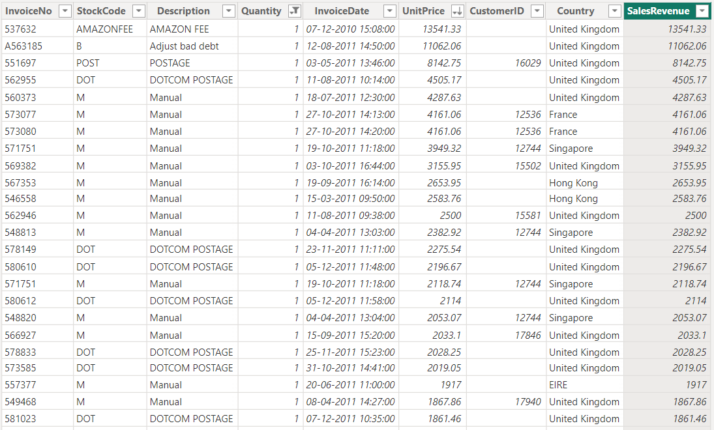
Dataset: Online retail sale

Slide 4
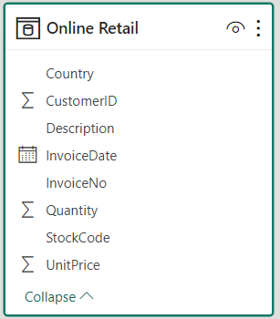
Steps required to get effective insights from given dataset:
Observe the data carefully and try to get some insights
Given: Online retail store dataset
Check whether data cleaning is required or not
Need to perform the following steps to clean this data:
Create a check that the quantity should not be below 1 unit
Create a check that the unit price should not be below $0

Slide 5
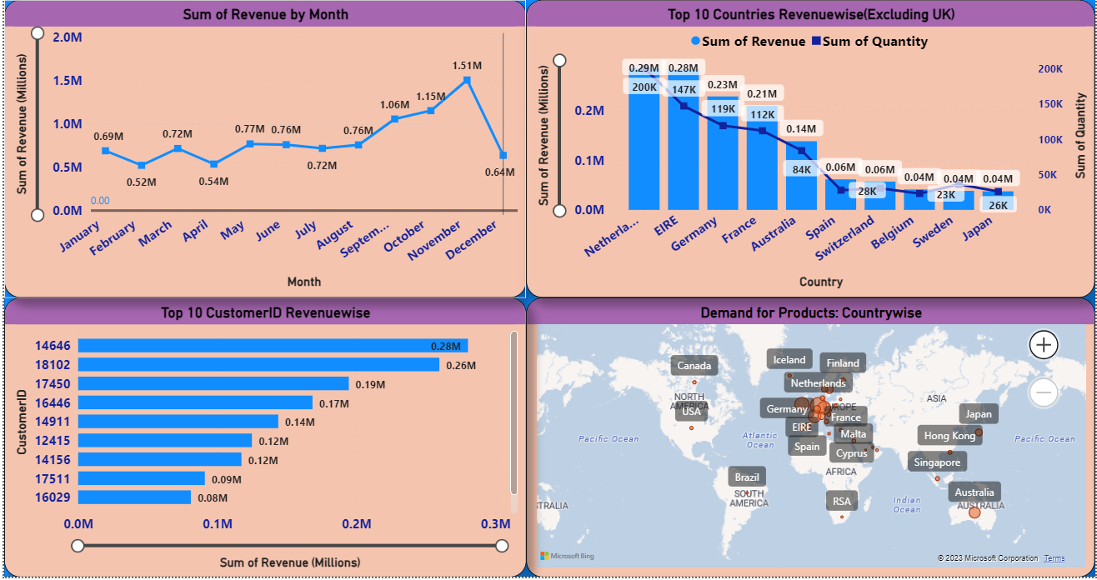
Choose correct KPIs(Key Parameter indicators)
Also called business success parameters
Quantifiable measurements that business leaders track to see if their strategies are working effectively
Example: Sales Performance KPIs
Sales Growth
Sales Target
ARPU(Average Revenue Per User)
CAC(Customer Acquisition Cost)
CLV(Customer Lifetime Value)
New Customers
Profit
Sales revenue
Create some detailed view charts, graphs, maps, lines
Use ‘geoms’ i.e. geometric objects as per business case

Slide 6
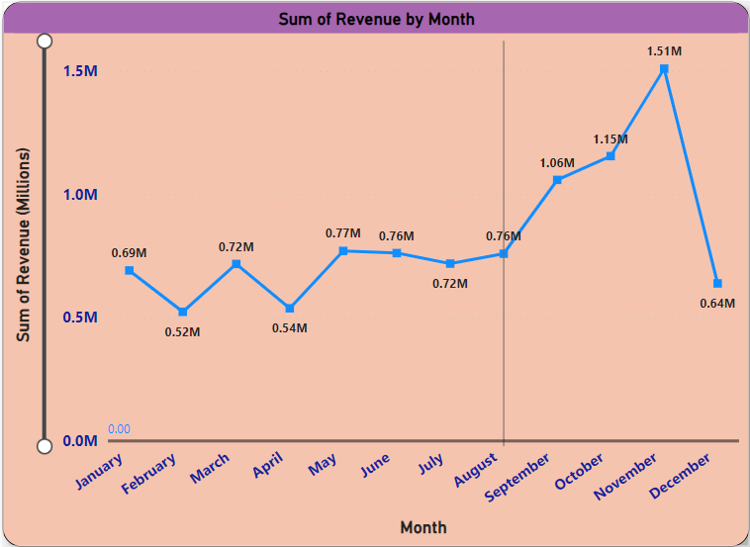
Question1 The CEO of the retail store is interested to view the time series of the revenue data for the year 2011 only. He would like to view granular data by looking into revenue for each month. The CEO is interested in viewing the seasonal trends and wants to dig deeper into why these trends occur. This analysis will be helpful for the CEO to forecast for the next year.
Insights:
Sum of Revenue trended down, resulting in a 7.60% decrease between January 2011 and December 2011.
﻿Sum of Revenue started trending up on June 2011, rising by 98.16% (7,47,756.43) in 5 months.
Sum of Revenue jumped from 7,61,739.90 to 15,09,496.33 during its steepest incline between June 2011 and November 2011.

Slide 7
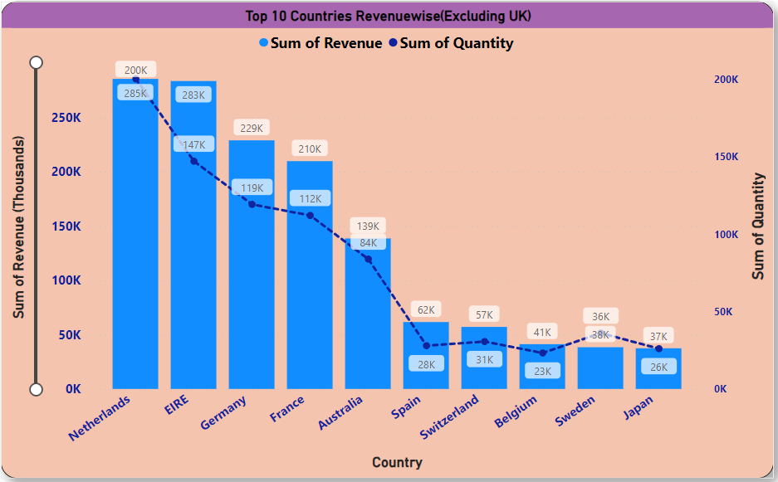
Question2 The CMO is interested in viewing the top 10 countries which are generating the highest revenue. Additionally, the CMO is also interested in viewing the quantity sold along with the revenue generated. The CMO does not want to have the United Kingdom in this visual.
Insights:
﻿At 2,85,446.34, Netherlands had the highest Sum of Revenue and was 662.89% higher than Japan, which had the lowest Sum of Revenue at 37,416.37.
﻿Sum of Revenue and total Sum of Quantity are positively correlated with each other.
﻿Netherlands accounted for 20.66% of Sum of Revenue.
﻿Sum of Revenue and Sum of Quantity diverged the most when the Country was EIRE, when Sum of Revenue were 1,36,280.96 higher than Sum of Quantity.

Slide 8
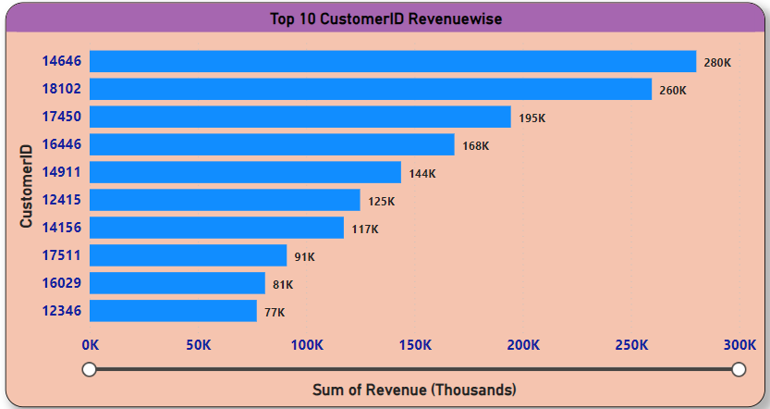
Question3 The CMO of the online retail store wants to view the information on the top 10 customers by revenue. He is interested in a visual that shows the greatest revenue generating customer at the start and gradually declines to the lower revenue generating customers. The CMO wants to target the higher revenue generating customers and ensure that they remain satisfied with their products.
Insights:
﻿At 2,80,206.02, 14646 had the highest Sum of Revenue and was 263.04% higher than 12346, which had the lowest Sum of Revenue at 77,183.60.
﻿14646 accounted for 18.22% of Sum of Revenue.
﻿Across all 10 CustomerID, Sum of Revenue ranged from 77,183.60 to 2,80,206.02.

Slide 9
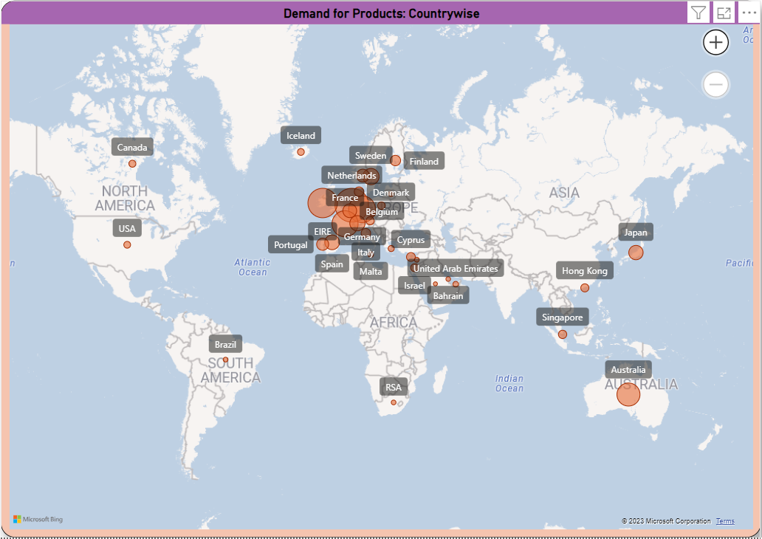
Question4 The CEO is looking to gain insights on the demand for their products. He wants to look at all countries and see which regions have the greatest demand for their products. Once the CEO gets an idea of the regions that have high demand, he will initiate an expansion strategy which will allow the company to target these areas and generate more business from these regions. He wants to view the entire data on a single view without the need to scroll or hover over the data points to identify the demand. There is no need to show data for the United Kingdom as the CEO is more interested in viewing the countries that have expansion opportunities.
Insights:
At 200361, Netherlands had the highest Sum of Quantity and was 2,50,351.25% higher than Saudi Arabia, which had the lowest Sum of Quantity at 80.
Netherlands had the highest Sum of Quantity at 200361, followed by EIRE and Germany. Saudi Arabia had the lowest Sum of Quantity at 80.
﻿Netherlands accounted for 21.64% of Sum of Quantity.
﻿Across all 37 Country, Sum of Quantity ranged from 80 to 200361.

Slide 10
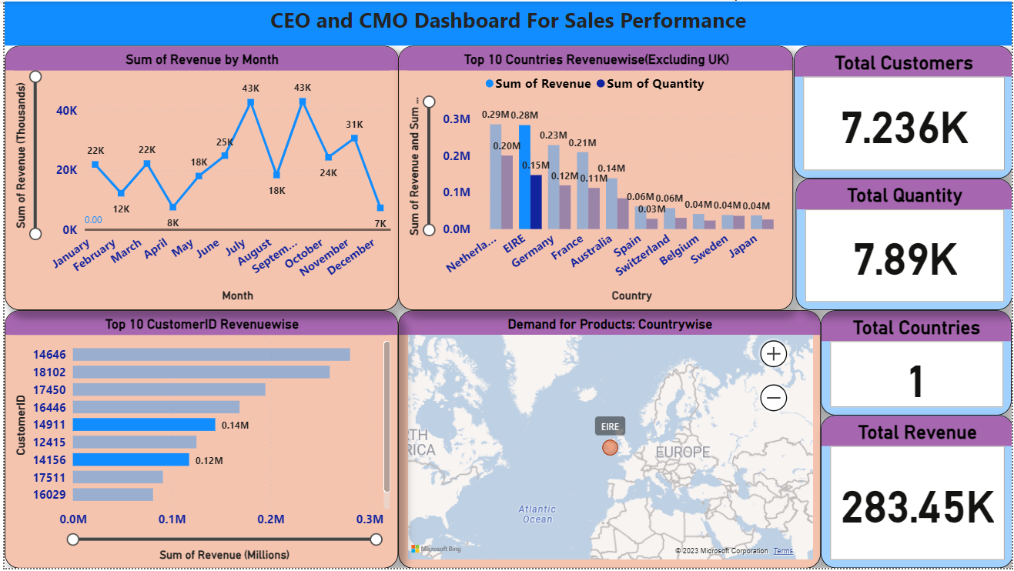
Create a Centralized dashboard for CEO/CMO
Example: Sales performance dashboard

Slide 11
Conclusion:
Insights: Revenue by month and Year(2011)
Sales Revenue trended down, resulting in a 7.60% decrease between January 2011 and December 2011 but Sales Revenue jumped from 7,61,739.90 to 15,09,496.33 during its steepest incline between June 2011 and November 2011. Thus, there is no steady pattern because in month of November, 2011 there is a peak and sales revenue touches $1.51million.
Takeaway: So there is need to analyze whether there was any seasonal sale or there were some fluctuations in market or both.
Insights: Top 10 Countries revenue wise (excluding U.K.)
﻿At 2,85,446.34, Netherlands had the highest Sales Revenue and was 662.89% higher than Japan, which had the lowest Sales Revenue at 37,416.37. (Remember: Highest sales revenue is generated by company from U.K. which we have excluded from our analysis.)
﻿Sum of Revenue and total Sum of Quantity are positively correlated with each other.
﻿Netherlands accounted for one fifth of total (20.66% ) of Sales Revenue.
Takeaway: U.K. is a type of outlier when we compare Sales Revenue of top 10 countries so we have to exclude it before generalizing the outcomes for dataset. Further, company can explore some scope for expansion of sales in Belgium, Sweden and Japan. However we don’t firmly suggest it because we don’t have other relevant KPIs like CLV(Customer Life time Value), CAC(Customer Acquisition Cost), profit margins name a few.

Slide 12
Conclusion contd…
Insights: Top 10 Customers Based on Sales Revenue
﻿At 2,80,206.02, Customer ID14646 had the highest Sum of Revenue and was 263.04% higher than Customer ID 12346, which had the lowest Sum of Revenue at 77,183.60.
﻿Customer ID14646 accounted for 18.22% of Sum of Revenue.
﻿Across all 10 CustomerID, Sum of Revenue ranged from 77,183.60 to 2,80,206.02.
Insights: Demand for products in different regions(Country wise)
At 200361, Netherlands had the highest Sum of Quantity and was 2,50,351.25% higher than Saudi Arabia, which had the lowest Sum of Quantity at 80.
Top 3 regions : Netherlands (21.64% ), EIRE and Germany.
Saudi Arabia had the lowest Sum of Quantity at 80.
﻿Across all 37 Country, Sum of Quantity ranged from 80 to 200361.

Slide 13
Script your story and analysis report
Conclusion or end with suggestions
Based on Statistics, Current data, Historical data
Current situation and Predictive projection
Beginning
Middle
End
Narrative
Visuals
Data
Components
Of
DataStorey Telling
Story Plot

